Slide 1
Module:4 Chapter:1
Evaluating Self-Explanations in iSTART: Word Matching, Latent Semantic Analysis, and Topic Models

Slide 2
Introduction
iSTART (Interactive Strategy Trainer for Active Reading and Thinking) is a web based, automated tutor designed to help students become better readers via multimedia technologies.
The reading strategies include:
(a) comprehension monitoring, being aware of one’s
understanding of the text
(b) paraphrasing, or restating the text in different
words
(c) elaboration, using prior knowledge or experiences
to understand the text.
(d) predictions, predicting what the text will say next
(e) bridging, understanding the relation between separate sentences of the text.

Slide 3
The computational challenge here is to provide appropriate feedback to the students concerning their self-explanations.
To do so requires capturing some sense of both the meaning and quality of the self-explanation.
iSTART was initially proposed as using Latent Semantic Analysis (LSA) to capture the meanings of texts and to assess the students’ self-explanation; however, while the LSA algorithms were being built, iSTART used simple word matching algorithms.

Slide 4
Our goal in evaluating the adequacy of the algorithms has been to imitate experts’ judgments of the quality of the self-explanations. The current evaluation system predicts the score that a human gives on a 4-point scale where:
0, represents an evaluation of the explanation as irrelevant or too short;
1, minimally acceptable;
2, better but including primarily the local textual context; and
3, oriented to a more global comprehension.

Slide 5
iSTART: Feedback Systems
iSTART was intended from the outset to employ LSA to determine appropriate feedback.
The initial goal was to develop one or more benchmarks for each of the SERT strategies relative to each of the sentences in the practice texts and to use LSA to measure the similarity of a trainee’s explanation to each of the benchmarks.

Slide 6
A benchmark is simply a collection of words, in this case, words chosen to represent each of the strategies (e.g., words that represent the current sentence, words that represent a bridge to a prior sentence).
a preliminary “word-based” (WB) system to provide feedback in our first version of iSTART so that we could provide a complete curriculum for use in experimental situations.
The second version of iSTART has integrated both LSA and WB in the evaluation process;

Slide 7
Word Matching Feedback Systems:
Word matching is a very simple and intuitive way to estimate the nature of a self explanation.
For each important word, an association list of synonyms and related terms was created by examining dictionaries and existing protocols as well as by human judgments of what words were likely to occur in a self-explanation of the sentence.
In the sentence “All thunderstorms have a similar life history,” for example, important words are thunderstorm, similar, life, and history

Slide 8
This was accomplished in two ways: (1) Literal word matching and (2) Soundex matching.
(1) Literal word matching : - Words are compared character by character and if there is a match of the first 75% of the characters in a word in the target sentence (or its association list) then we call this a literal match.
(2) Soundex matching: - This algorithm compensates for misspellings by mapping similar characters to the same soundex symbol .
Words are transformed to their soundex code by retaining the first character, dropping the vowels, and then converting other characters into soundex symbols

Slide 9
Latent Semantic Analysis (LSA) Feedback Systems
uses statistical computations to extract and represent the meaning of words.
Meanings are represented in terms of their similarity to other words in a large corpus of documents.
To construct an LSA corpus matrix, a collection of documents are selected. A document may be a sentence, a paragraph, or larger unit of text.
A term-document frequency (TDF) matrix X is created for those terms that appear in two or more documents.

Slide 10
The row entities correspond to the words or terms (hence the W) and the column entities correspond to the documents (hence the D).
The matrix is then analyzed using Singular Value Decomposition (SVD)that is the TDF matrix X is decomposed into the product of three other matrices:
(1) vectors of derived orthogonal factor values of the original row entities W,
(2) vectors of derived orthogonal factor values of the original column entities D, and
(3) scaling values (which is a diagonal matrix) S

Slide 11

The product of these three matrices is the original TDF matrix.
{X} = {W}{S}{D}
These documents consist of terms, which are represented by term vectors; hence, the document can be represented as a document vector which is computed as the sum of the term vectors of its terms:

Slide 12
The rating is based on formulae that use weighted sums of the four LSA cosines between the explanation and each of the four benchmarks.
The four benchmarks include:
1) the words in the title of the passage (“title”),
2) the words in the sentence (“current sentence”),
3) words that appear in prior sentences in the text that are causally related to the sentence (“prior text”), and
4) words that did not appear in the text but were used by two or more subjects who explained the sentence during experiments (“world knowledge”)

Slide 13
When LSA was combined with a fully automated word-based system and we found that world knowledge benchmark could be dropped. Hence, only three benchmarks are used for LSA-based factors:
1) the words in the title of the passage,
2) the words in the sentence, and
3) the words in the two immediately prior sentences. From the word-based values we include
4) the number of content words matched in the target sentence,
5) the number of content words matched in the prior sentences,
6) the number of content words matched in the subsequent sentences, and
7) the number of content words that were not matched in 4, 5, or 6.

Slide 14
Topic Models (TM) Feedback System:
The Topic Models approach applies a probabilistic model in finding a relationship between terms and documents in terms of topics.
By using a TM matrix, we can estimate the probability that a certain topic was used in the creation of a given document.
If two documents are similar, the estimates of the topics they probably contain should be similar.
TM is very similar to LSA, except that a term-document frequency matrix is factored into two matrices instead of three.

Slide 15
{Xnormalized} = {W}{D}
The dimension of matrix {W} is W x T,
where W is the number of words in the corpus and T is number of topics.
TM toolbox takes care of this normalization and outputs for each topic, the topic probability, and a list of terms in this topic along with their probabilities in descending order (shown in Table). This output is easily transformed into the term-topic-probability matrix.

Slide 16
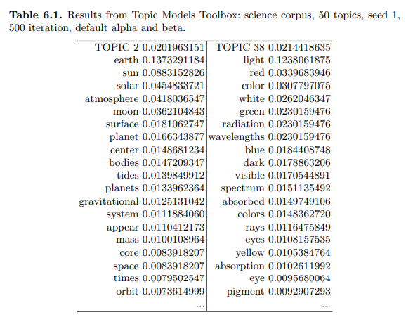

Slide 17
Metacognitive Statements :
The feedback systems include a metacognitive filter that searches the trainees’ self explanations for patterns indicating a description of the trainee’s mental state such as “now I see ...” or “I don’t understand this at all.”
The metacognitive filter also benefits the feedback system.
If the self-explanation contains only a metacognitive statement, the system will respond to a metacognitive category such as understanding, not-understanding, confirmation, prediction, or boredom instead of responding irrelevantly. R

Slide 18
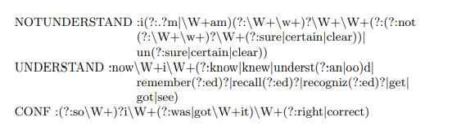
Examples of regular expression are shown below:

Slide 19
iSTART: Evaluation of Feedback Systems:
Self-Explanations: The self-explanations were collected from 45 middle-school students (entering 8th and 9th grades) who were provided with iSTART training and then tested with two texts, Thunderstorm and Coal. The texts were shortened versions of the texts used in Experiment 1, consisting of 13 and 12 sentences, respectively. This chapter presents only the data from the Coal text.

Slide 20
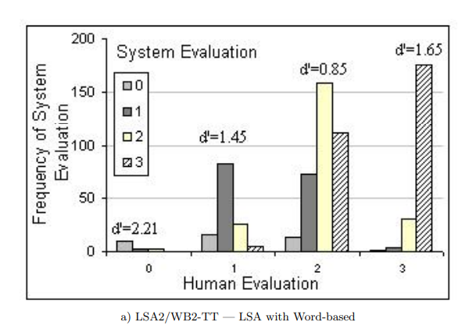

Slide 21
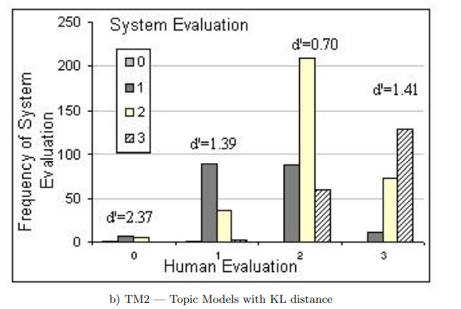

Slide 22
Results: In contrast to the human coding system used in Experiment 1, the coding system applied to this data was not intended to map directly onto the iSTART evaluation systems. In this case, the codes are categorical and do not necessarily translate to a 0-3 quality range. One important goal is to be able to assess (or discriminate) the use of reading strategies and improve the system’s ability to appropriately respond to the student. This is measured in terms of percent agreement with human judgments of each reading strategy shown in Table

Slide 23
Module:4 Chapter:2
Textual Signatures: Identifying Text-Types Using Latent Semantic Analysis to Measure the Cohesion of Text Structures:

Slide 24
Introduction:
Texts contain pertinent information that co-refers across sentences and paragraphs ,texts contain relations between phrases, clauses, and sentences that are often causally linked; and texts that depend on relating a series of chronological events contain temporal features that help the reader to build a coherent representation of the text.
We refer to textual features such as these as cohesive elements, and they occur within paragraphs (locally), across paragraphs (globally), and in forms such as referential, causal, temporal, and structural

Slide 25
Cohesion:
Importance of the cohesion of a text in comprehension, Cohesion is the degree to which ideas in the text are explicitly related to each other and facilitate a unified situation model for the reader.
Recent developments in computational linguistics and discourse processing have now made it possible to measure this textual cohesion.
These developments have come together in a computational tool called Coh-Metrix

Slide 26
Coh-Metrix:
Coh-Metrix assesses characteristics of texts by using parts of speech classifiers, and latent semantic analysis.
The indices generated from Coh-Metrix offer an assessment of the cohesiveness and readability of any given text.
For example, Louwerse et al. used Coh-Metrix to investigate variations in cohesion across written and spoken texts, finding evidence for a significant difference between these modes.

Slide 27
Approaches to Analyzing Texts :
Traditional approaches to categorizing discourse have tended to treat text as if it were a homogeneous whole.
These wholes, or bodies of text, are analyzed for various textual features, which are used to classify the texts as belonging to one category or another.
The parts of a text serve the textual whole either by function or by form.

Slide 28
In terms of form, numerous theories of text structure have demonstrated how textual elements are inter-related.
The limited success in identifying textual segments may be the result of searching for a reliable fine grained analysis before a courser grain has first been established.
If we accept that texts are comprised of parts, and that the text (as a whole) is dependent upon the presence of each part, then we can form the hypothesis that the parts of the text are inter-dependent and, therefore, are likely to be structurally inter-related.

Slide 29
Latent Semantic Analysis:
LSA is a technique that uses a large corpus of texts together with singular value decomposition to derive a representation of world knowledge.
LSA’s practical advantage over shallow word overlap measures is that it goes beyond lexical similarities such as chair/chairs or run/ran, and manages to rate the relative semantic similarity between terms such as chair/table, table/wood, and wood/forest.

Slide 30
Predictions:
The abstract outlines the theme of the study (introduction); it can refer to the basic method used in the study (methods); it will briefly state a prominent result from the study (results); and it will then discuss the relevance of the studys findings (discussions).
we predicted that abstracts would feature far greater reference to the introduction (AI comparison type) and discussion sections (AD comparison type), less reference to the results section (AR comparison type), and less reference still to the methods section (AM comparison type).

Slide 31
Methods:
we extracted from this corpus only the texts that were comprised of five author-identified sections: abstract, Introduction, methods, results, discussion.
Results of Experiment 1 :
To examine differences in relatedness of the abstract to each of the text sections, we conducted a repeated measures Analysis of Variance (ANOVA) on the LSA cosines including the within-text factors of AI (M=.743, SD=.110), AM (M=.545, SD=.151), AR (M=.637, SD=.143), and AD (M=.742, SD=.101).

Slide 32
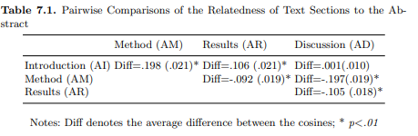
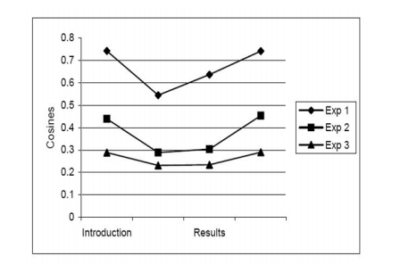

Slide 33
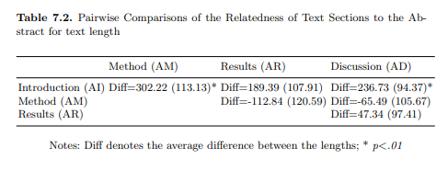
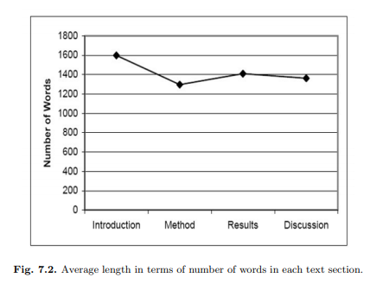

Slide 34
Module:4
Chapter:3
Automatic Document Separation: A Combination of Probabilistic Classification and Finite-State Sequence Modeling

Slide 35
Introduction:
Large organizations are increasingly confronted with the problem of capturing, processing, and archiving large amounts of data.
First, the weight, volume, and relative fragility of paper incur problems in handling and require specific, labor-intensive processes to be applied.
Second, for automatic processing, the information contained on the pages must be digitized, performing Optical Character Recognition (OCR)

Slide 36
As an example, consider the processing of loan documents in the mortgage industry: Usually, documents originate at local branch offices of an organization (e.g., bank branches, when a customer fills out and signs the necessary forms and provides additional information).
All loan documents finalized at a local office on a given day are collated into one stack of paper (called a batch) and sent via surface mail to a centralized processing facility.

Slide 37
The process of manually inserting separator sheets into loan files. A person must take a loan file, leaf through the stack of paper (hundreds of pages), and insert appropriate separators at the correct boundary points.
It is challenging, since the person needs to have a fair amount of knowledge of loan documents(hundreds of document categories) and work with a high degree of attention to detail.

Slide 38
Related Work:
Extraction rules define areas of interest on a form and how to gather data from those zones.
Maximum Entropy (ME) methods have proven very successful in the area of segmentation of natural language sentences.
They define a similarity measure between two pages that takes document structure (text in headers and footers, esp. page numbers), layout information (font structure), and content (text on pages) into account

Slide 39
Data Preparation:
We are primarily reporting on data from the mortgage processing industry, hence the document types ,Our sample here contains documents from 30 document types.
The quality of the images varies based on their origin (original or photocopy) and treatment (fax). Figures (one from a Loan Application, one from a Note) and some of the OCR text generated from them.

Slide 40
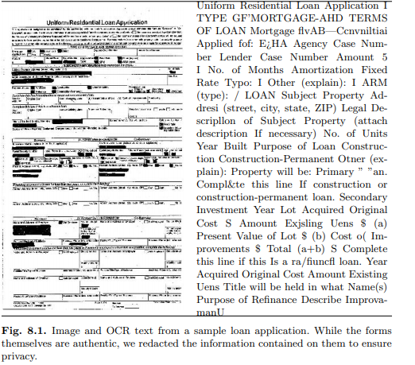

Slide 41
By stemming, we assume that the detailed morphological description of words is irrelevant for the purpose of classification. For instance, we are unable to tell whether the feature “address” in Table came from the input “address,” “addresses,” or “addressing.” Inflectional and part-of-speech information is lost.
Using bags of words, we are abstracting from the linear structure of the input text. We pose that there is little value in knowing which word appeared before or near another and the only important information is in knowing which word appears more frequently than others.
The application of a stop word list, finally, de-emphasizes the value of syntactic information even further, since many syntactically disambiguating words are ignored

Slide 42
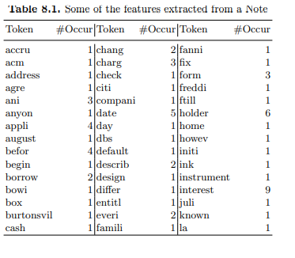

Slide 43
Document Separation as a Sequence Mapping Problem
Automatic Document Separation adds two pieces of information to a stream of unlabeled pages.
The problem can be seen as the mapping of an input sequence to an output sequence, i.e., a sequence of scanned paper pages is mapped to a sequence of document types.
A sequence of human readable program statements to a sequence of machine code, a sequence of acoustic signals to a sequence of words, a sequence of words to a sequence of tags, and a sequence of, e.g., Spanish words to a sequence of French words.

Slide 44
In this chapter, we utilize these concepts to solve the problem of document separation: Map a given sequence of pages to all possible output sequences, i.e., sequences of document types, determine for each output sequence its probability given the input sequence, find the most likely output sequence (sequence of document types), and, thus, effectively separate the sequence of input pages by document type.

Slide 45
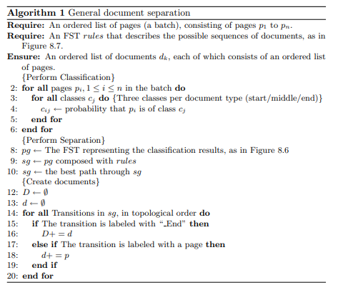

Slide 46
Module:4
Chapter:4
Evolving Explanatory Novel Patterns for Semantically-Based Text Mining

Slide 47
Motivation:
An important problem with mining textual information is that in this unstructured form is not readily accessible to be used by computers.
This technology is usually referred to as Text Mining, and aims at discovering unseen and interesting patterns in textual databases.
These discoveries are useless unless they contribute valuable knowledge for users who make strategic decisions (i.e., managers, scientists, businessmen).
This leads then to a complicated activity referred to as Knowledge Discovery from Texts (KDT) which, like Knowledge Discovery from Databases (KDD), correspond to “the non-trivial process of identifying valid, novel, useful and understandable patterns in data”

Slide 48
In terms of data mining techniques, Genetic Algorithms (GA) for Mining purposes has several promising advantages over the usual learning/analysis methods employed in KDT:
The ability to perform global search (traditional approaches deal with predefined patterns and restricted scope), the exploration of solutions in parallel, the robustness to cope with noisy and missing data (something critical in dealing with text information as partial text analysis techniques may lead to imprecise outcome data), and the ability to assess the goodness of the solutions as they are produced.
The approach combines Information Extraction (IE) technology and multi-objective evolutionary computation techniques. It aims at extracting key underlying linguistic knowledge from text documents and then hypothesizing and assessing interesting and unseen explanatory knowledge

Slide 49
Related Work:
Typical approaches to text mining and knowledge discovery from texts are based on simple bag-of-words (BOW) representations of texts which make it easy to analyse them but restrict the kind of discovered knowledge.
Traditional approaches to KDT share many characteristics with classical DM but they also differ in many ways: many classical DM algorithms are irrelevant or ill suited for textual applications as they rely on the structuring of data and the availability of large amounts of structured information.

Slide 50
Bag-of-Words-Based Approaches
Some of the early work on TM came from the Information Retrieval community, hence the assumption of text represented as a Bag-of-Words (BOW), and then to be processed via classical DM methods.
Once the initial information (i.e., terms, keywords) has been extracted, KDD operations can be carried out to discover unseen patterns. Representative methods in this context have included Regular Associations , Concept Hierarchies, Full Text Mining ,Clustering, Self-Organising Maps.
The systems may be able to detect relations or associations between items, but they cannot provide any description of what those relations are. At this stage, it is the user’s responsibility to look for the documents involved with those concepts and relations to find the answers

Slide 51
High-Level Representation Approaches
Another main stream in KDT involves using more structured or higher-level representations to perform deeper analysis so to discover more sophisticated novel / interesting knowledge.
One of the main advantages of this method is its low cost for augmenting the structure of WordNet and its simplicity of relations.
A natural further important step would be using knowledge base such as WordNet to support text inference to extract relevant, unstated information from the text.
Although DM tasks have been commonly tackled as learning problems, the nature of DM suggests that the problem of DM (i.e., finding unseen, novel and interesting patterns) should be seen as involving search (i.e., different hypotheses are explored) and optimization (i.e., hypotheses which maximize quality criteria should be preferred) instead.

Slide 52
One of the major contributions of evolutionary algorithms (e.g., GAs) for an important number of DM tasks (e.g., rule discovery, etc.) is that they tend to cope well with attribute interactions.
This is in contrast to the local, greedy search performed by often-used rule induction and decision-tree algorithms.
Typical tasks for GAs in DM have included Classification; in which the goal is to predict the value (the class) of a user-defined goal attribute based on the values of other attributes; Discovery of Association rules; where binary attributes (items) contained in data instances (i.e., records) are used to discover associations of the form IF-THEN, Rule discovery/prediction; in which the system can produce many different combinations of attributes.

Slide 53
A Semantically Guided Model for Effective Text Mining
We have adopted GAs as central to our approach to KDT.
In order to deal with issues regarding representation and new genetic operations so to produce an effective KDT process, our working model has been divided into two phases.
The first phase is the preprocessing step aimed to produce both training information for further evaluation and the initial population of the GA.
The second phase constitutes the knowledge discovery itself, in particular this aims at producing and evaluating explanatory unseen hypotheses.

Slide 54
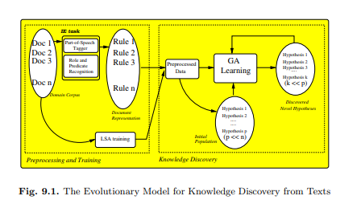
The whole processing starts by performing the IE task (Figure ) which applies extraction patterns and then generates a rule-like representation for each document of the specific domain corpus. After processing a set of n documents, the extraction stage will produce n rules, each one representing the document’s content in terms of its conditions and conclusions. Once generated, these rules, along with other training data, become the “model” which will guide the GA-based discovery

Slide 55
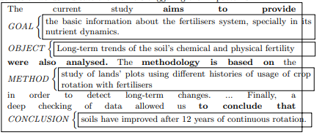
Text Preprocessing and Training:
The preprocessing phase has two main goals: to extract important information from the texts and to use that information to generate both training data and the initial population for the GA.
From such a structure, important constituents can be identified:
Rhetorical Roles (discourse-level knowledge): these indicate important places where the author makes some “assertions” about his/her work (i.e., the author is stating the goals, used methods, achieved conclusions, etc.). In the example above, the roles are represented by goal, object of study, method and conclusion

Slide 56
Predicate Relations: these are represented by actions (predicate and arguments) which are directly connected to the role being identified and state a relation which holds between a set of terms (words which are part of a sentence), a predicate and the role which they are linked to. Thus, for the example, they are as follows: provide(‘the basic information ..’), analyse(‘long-term trends ...’), study(‘lands plot using ...’), improve(‘soil ..improved after ..’).
Causal Relation(s): Although there are no explicit causal relations in the above example, we can hypothesise a simple rule of the form: IF the current goals are G1,G2, .. and the means/methods used M1,M2, .. (and any other constraint/feature) THEN it is true that we can achieve the conclusions C1,C2, .. Finally, the sample abstract may be represented in a rule-like form as follows:
IF goal(provide(‘the basic information ..’)) AND
object(analyse(‘long-term trends ...’)) AND method(study(‘lands
plot using ...’)) THEN conclusion(improve(‘soil ..improved after ..’))

Slide 57
Key training data are captured from the corpus of documents itself and from the semantic information contained in the rules. This can guide the discovery process in making further similarity judgements and assessing the plausibility of the produced hypotheses.
Training Information from the Corpus:It has been suggested that huge amounts of texts represent a valuable source of semantic knowledge. In particular, in Latent Semantic Analysis (LSA) it is claimed that this knowledge is at the word level.
We perform two kinds of tasks: creating the initial population and computing training information from the rules.
Creating the initial population of hypotheses
Computing training information (in which two kinds of training data are obtained):
a) Computing correlations between rhetorical roles and predicate relations.
b) Computing co-occurrences of rhetorical information

Slide 58
Knowledge Discovery and Automatic Evaluation of Patterns
Our approach to KDT is strongly guided by semantic and rhetorical information, and consequently there are some soft constraints to be met before producing the offspring so as to keep them coherent.
The GA will start from a initial population, which in this case, is a set of semi random hypotheses built up from the preprocessing phase.
Hypothesis Discovery: Using the semantic measure above and additional constraints discussed later on, we propose new operations to allow guided discovery such that unrelated new knowledge is avoided, as follows:
Selection: selects a small number of the best parent hypotheses of every generation (Generation Gap) according to their fitness.
Crossover: a simple recombination of both hypotheses’ conditions and conclusions takes place, where two individuals swap their conditions to produce new offspring (the conclusions remain).

Slide 59
• Mutation: aims to make small random changes on hypotheses to explore new possibilities in the search space. As in recombination, we have dealt with this operation in a constrained way, so we propose three kinds of mutations to deal with the hypotheses’ different objects:
a) Role Mutation: one rhetorical role (including its contents: relations and arguments) is selected and randomly replaced by a random one from the initial role database.
b) Predicate Mutation: one inner predicate and its argument is selected and randomly replaced with another predicate-argument pair from the initial predicate databases.
c) Argument Mutation: since we have no information about arguments’ semantic types, we choose a new argument by following a guided procedure in which the former argument is randomly replaced with that having a high semantic similarity via LSA.

Slide 60
• Population Update: we use a non-generational GA in which some individuals are replaced by the new offspring in order to preserve the hypotheses’ good material from one generation to other, and so to encourage the improvement of the population’s quality.
Evaluation: Evolutionary Multi Objective Optimization (EMOO) techniques which use the multiple criteria defined for the hypotheses are needed.
It will produce a 8-dimensional vector of objective functions) given by:
relevance, structure, cohesion, interestingness, coherence, coverage, simplicity, plausibility of origin.

Slide 61
• Structure (How good is the structure of the rhetorical roles?): measures how much of the rules’ structure is exhibited in the current hypothesis.
• Cohesion (How likely is a predicate action to be associated with some specific rhetorical role?): measures the degree of “connection” between rhetorical information (i.e., roles) and predicate actions.
Interestingness (How interesting is the hypothesis in terms of its antecedent and consequent?): Unlike other approaches to measure “interestingness” which use an external resource (e.g., WordNet) and rely on its organisation, we propose a different view where the criterion can be evaluated from the semi-structured information provided by the LSA analysis.
Coherence: This metrics addresses the question whether the elements of the current hypothesis relate to each other in a semantically coherent way.

Slide 62
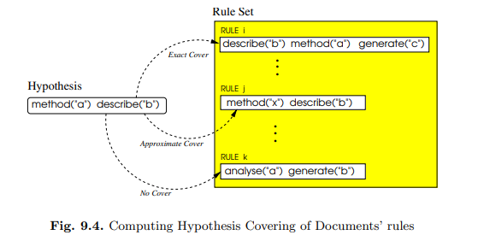
Coverage: The coverage metric tries to address the question of how much the hypothesis is supported by the model (i.e., rules representing documents and semantic information).
Simplicity (How simple is the hypothesis?): shorter and/or easy-to-interpret hypotheses are preferred. Since the criterion has to be maximised, the evaluation will depend on the length (number of elements) of the hypothesis.

Slide 63

Plausibility of Origin (How plausible is the hypothesis produced by Swanson’s evidence?): If the current hypothesis was an offspring from parents which were recombined by a Swanson’s transitivity-like operator, then the higher the semantic similarity between one parent’s consequent and the other parent’s antecedent, the more precise is the evidence, and consequently worth exploring as a novel hypothesis.
Accordingly, the criterion for a hypothesis H is simply given by:

Slide 64
Analysis and Results:
two basic questions concerning our original aims:
a) How well does the GA for KDT behave?
b) How good are the hypotheses produced according to human experts in terms of text mining’s ultimate goals: interestingness, novelty and usefulness, etc.
In order to address these issues, we used a methodology consisting of two phases: the system evaluation and the experts’ assessment.
a) System Evaluation: this aims at investigating the behavior and the results produced by the GA.
We set the GA by generating an initial population of 100 semi-random hypotheses. In addition, we defined the main global parameters such as Mutation Probability (0.2), Crossover Probability (0.8), Maximum Size of Pareto set (5%), etc

Slide 65
b) Expert Assessment: this aims at assessing the quality (and therefore, effectiveness) of the discovered knowledge on different criteria by human domain experts.
For this, we designed an experiment in which 20 human experts were involved and each assessed 5 hypotheses selected from the Pareto set. We then asked the experts to assess the hypotheses from 1 (worst) to 5 (best) in terms of the following criteria: Interestingness (INT), Novelty (NOV), Usefulness (USE) and Sensibleness (SEN).

Slide 66
. In natural-language text, this can roughly be interpreted as (each item of the following NL description represents a predicate-level information of hypothesis above):
• IF the work aims at performing the genetic grouping of seed populations and investigating a tendency to the separation of northern populations into different classes, AND
• The goal is to analyse the vertical integration for producing and selling Pinus Timber in the Andes-Patagonia region.
• THEN as a consequence, the best agricultural use for land lots of organic agriculture must be established to promote a conservationist culture in priority or critical agricultural areas.

Slide 67
Another of the discovered patterns is given by hypothesis 88 of run 3, which is represented as follows:
IF goal(present(11511))
AND method(use(25511))
THEN effect(1931,1932)
In natural-language text, this can roughly be interpreted as:
• IF the goal is to present a two-dimensional scheme for forest restoration in which two regression models with Pinus and without Pinus are identified by inspiring in the natural restoring dynamics, AND
• The method is based on the use of micro-environments for capturing the kind of farm mice called Apodemus Sylvaticusi, and on the use of capture traps at a rate of 1464 traps per night.
• THEN, in vitro digestion of three cutting ages in six ecotypes has an effect on ”Bigalta” cuttings which got their higher performance in a 63-day period

Slide 68
Another example of discovered patterns is a low-scored hypothesis given by the following hypothesis 52:
IF object(perform(20611)) AND
object(carry_out(2631))
THEN effect(1931,1932)
In natural-language text, the pattern can roughly be interpreted as:
IF the object of the work is to perform the analysis of the fractioned honey in Brazil for improving the producers’ income and profitability, AND
• The object of the work is to carry out observations for the study of Pinus hartwegii at the mexican snowed hills so to complement the previously existing information about the development status of Adjunctus and its biology.
• THEN in vitro digestion of three cutting ages in six ecotypes has an effect on bigalta cuttings which got their higher performance in a 63-day period.

